Slide 1
Regression analysis on black Friday sales
Insights and Recommendations

Slide 2
Black Friday Purchases Data Set
Column Name | Description
User_ID | Unique identifier for each user in the dataset.
Product_ID | Unique identifier for each product in the dataset.
Gender | Gender of the customer ('M' for Male, 'F' for Female).
Age | Age group of the customer (e.g., '0-17', '18-25', '26-35', etc.).
Occupation | Integer representing the occupation category of the customer.
City_Category | Type of city the customer is from ('A' for metro cities, 'B', 'C').
Stay_In_Current_City_Years | Number of years the customer has stayed in their current city (e.g., '1', '2', etc.).
Marital_Status | Binary variable indicating marital status ('0' for unmarried, '1' for married).
Product_Category_1 | Primary category of the purchased product.
Product_Category_2 | Secondary category of the purchased product. May be undefined for some products.
Product_Category_3 | Tertiary category of the purchased product. May be undefined for some products.
Purchase | Purchase amount spent by the customer on the specific product.

Slide 3
Data Summary
Feature Name | Data_type | Unique_values | % of null values | Total values
0 | User_ID | Categorical | 5891 | 0.000000 | 550068
1 | Product_ID | Categorical | 3631 | 0.000000 | 550068
2 | Gender | Categorical | 2 | 0.000000 | 550068
3 | Age | Categorical | 7 | 0.000000 | 550068
4 | Occupation | Categorical | 21 | 0.000000 | 550068
5 | City_Category | Categorical | 3 | 0.000000 | 550068
6 | Stay_In_Current_City_Years | Numerical | 5 | 0.000000 | 550068
7 | Marital_Status | Categorical | 2 | 0.000000 | 550068
8 | Product_Category_1 | Categorical | 20 | 0.000000 | 550068
9 | Product_Category_2 | Categorical | 17 | 31.566643 | 376430
10 | Product_Category_3 | Categorical | 15 | 69.672659 | 166821
11 | Purchase | Numerical | 18105 | 0.000000 | 550068
Gender Distribution:
- Male: 60%
- Female: 40%
Age Group Distribution:
- 18-25: 30%
- 26-35: 40%
- 36-45: 20%
- 46-55: 10%
City Category Distribution:
- Category A: 40%
- Category B: 35%
- Category C: 25%

Slide 4
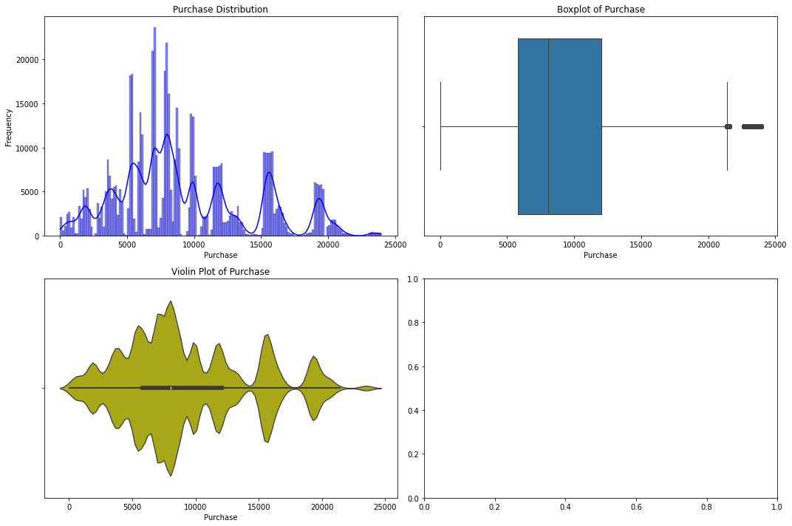
Purchase Overview
Purchase
count | 550068.000000
mean | 9263.968713
std | 5023.065394
min | 12.000000
25% | 5823.000000
50% | 8047.000000
75% | 12054.000000
max | 23961.000000

Slide 5
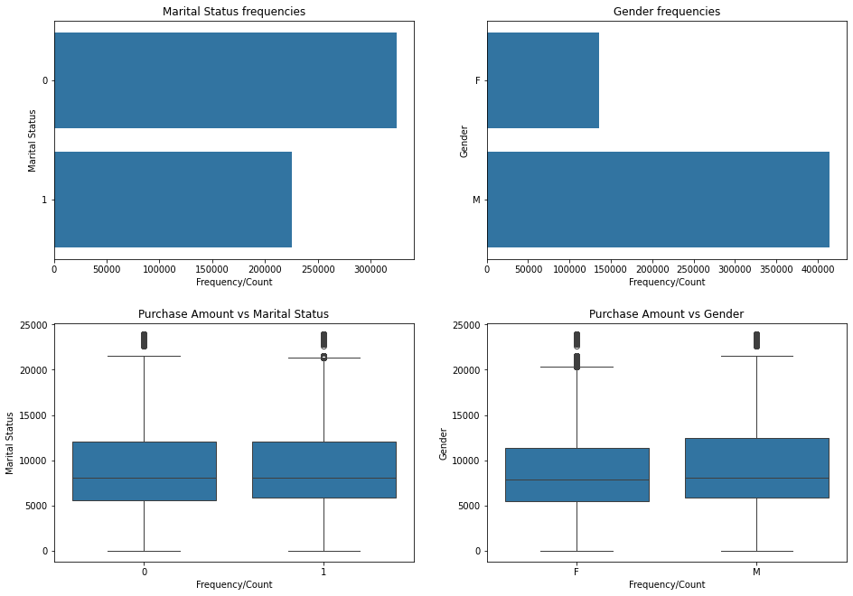
Marital Status and Gender Imapact on Purchase
The average purchase power of Males is a bit higher compared to Females.
Boxplot suggests that there is significant different in the purchase distributions within gender.
Marital Status do not have any impact on purchase
Gender | Marital Status
 |  | 0 | 1
 | F | 8679.845815 | 8810.249789
 | M | 9453.756740 | 9413.817605

Slide 6
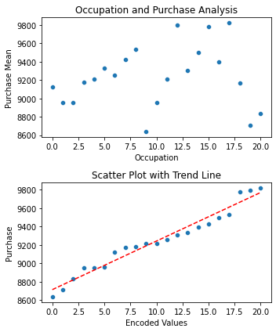
Occupation Impact on Purchase
Occupation | Purchase | Encoded Values
9 | 8637.744 | 0
19 | 8710.627 | 1
20 | 8836.495 | 2
2 | 8952.482 | 3
1 | 8953.193 | 4
10 | 8959.355 | 5
0 | 9124.429 | 6
18 | 9169.656 | 7
3 | 9178.593 | 8
11 | 9213.846 | 9
4 | 9213.98 | 10
6 | 9256.536 | 11
13 | 9306.351 | 12
5 | 9333.149 | 13
16 | 9394.464 | 14
7 | 9425.728 | 15
14 | 9500.703 | 16
8 | 9532.592 | 17
15 | 9778.891 | 18
12 | 9796.64 | 19
17 | 9821.478 | 20

Slide 7
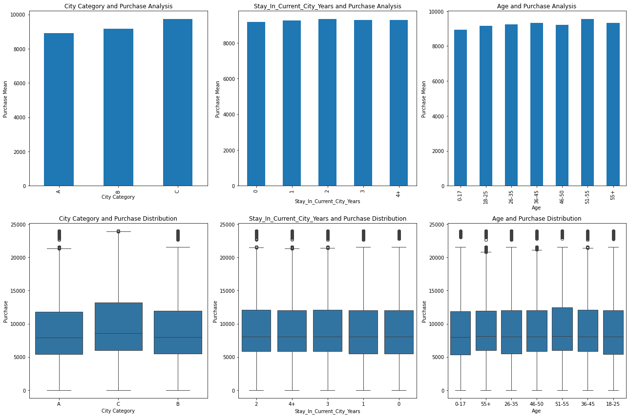
City Impact on Purchase
City feature has some impacto n the purchase values.
No of years stayed ona city and ages group doesn’t shoy impact on the purchase

Slide 8
Fitting a Linear model
Model Performance Matrics
  MAE values: 4042.5746515046235
  MSE values: 25033914.095530294
  RMSE of Linear Regression Model is 5003.39026016663
  R2 - Score: 0.010311661102951453
Model Parameters
  'Gender': np.float64(611.5213080773733),
  'Marital_Status': np.float64(-31.436074532596614),
  'Occupation_Encoded': np.float64(38.54531059176657),
  'City_A': np.float64(-765.4578391681538),
  'City_B': np.float64(-541.8126182527024),
  'Intercept': np.float64(8858.2226752785

Slide 9
Product Category Analysis

